Slide 1
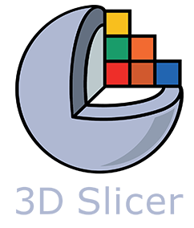


Segmentation Statistical Modeling Notes
O’Connell Biomechanics Lab
Yousuf + Sylvi
Spring 2025

Slide 2
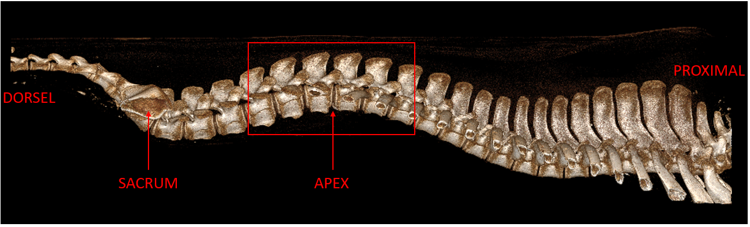
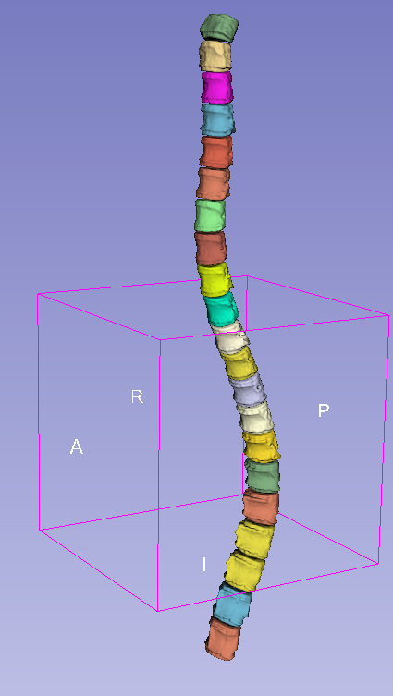
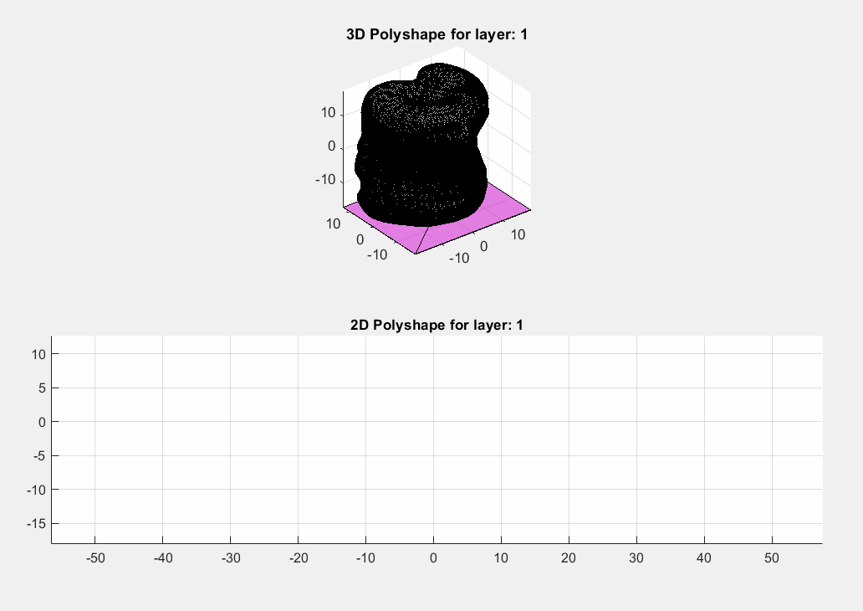
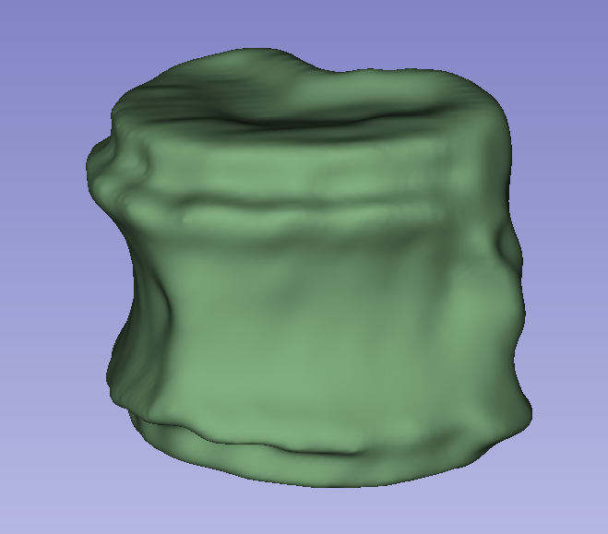
Measurement Procedure Overview
Raw imaging data
Full spine segmentation
Assumes: 15 thoracic + 6 lumbar levels
(Automated) MATLAB measurements
Single level segmentation
Notes:
Generally, I’ve found the 15 thoracic + 6 lumbar partition to be a good representation of the spine but some porcine subjects seem to one extra lumbar or thoracic level. Ultimately, the most important thing to capture is the spinal curvature, so is there anything that’s being left out in this representation?
We stick to the convention that the bottommost rib corresponds to the lowest thoracic level.

Slide 3
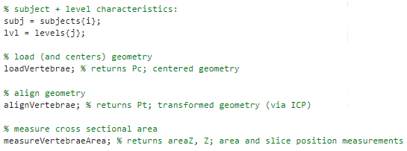
MATLAB Program Overview
main.m:
{
Looping through each subject and vertebral level
{
Loads and re-aligns the geometry (via the ICP algorithm)
{
Calculates and plots area (mm^2) and height (mm) measurements
{
Calculates volume (mm^3) and surface area (mm^2)

Slide 4
Area Measurement Procedure Animation

Slide 5
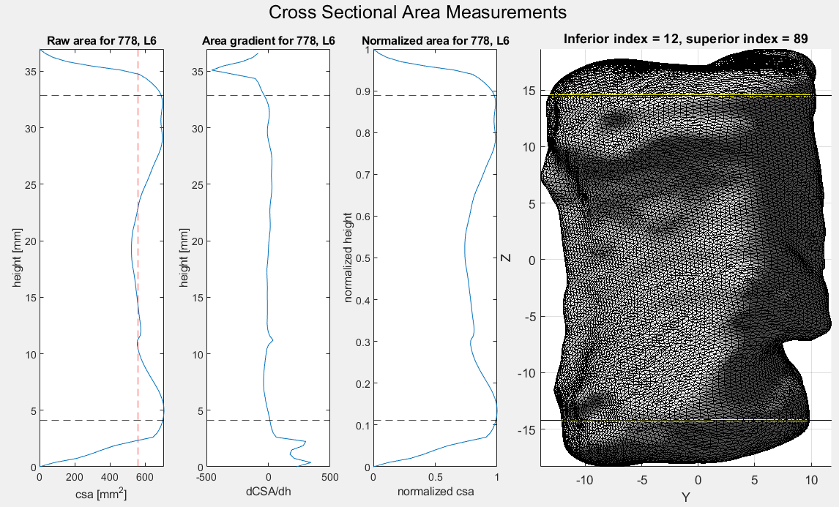
MATLAB Program Overview: Area Measurements
Landmark selection points are passed into height measurement program

Slide 6
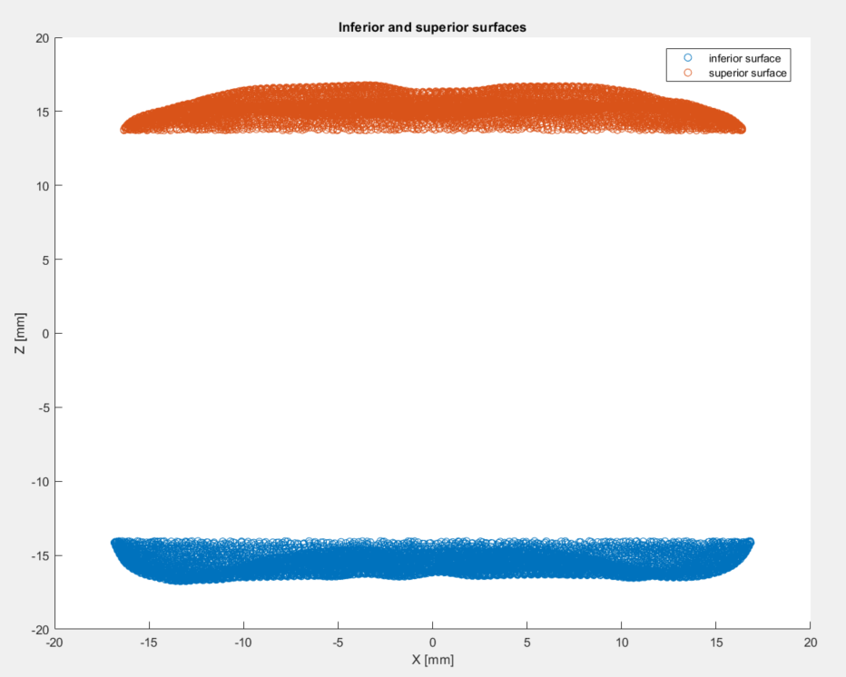
MATLAB Program Overview: Landmark Selection Process
The central vertebral body is removed!
3D superior + inferior surfaces are made and height distributions are measured.

Slide 7
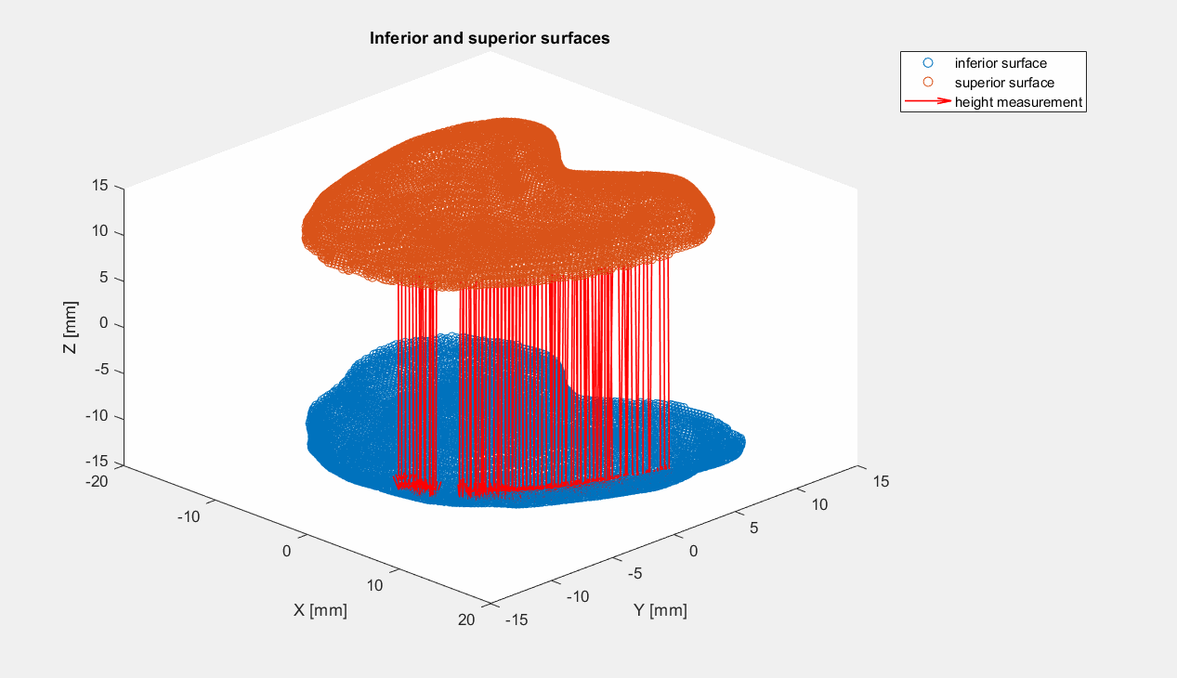
Review: Height Measurement Procedure Animation
Height measurements: superior points are projected directly downwards onto the inferior points

Slide 8
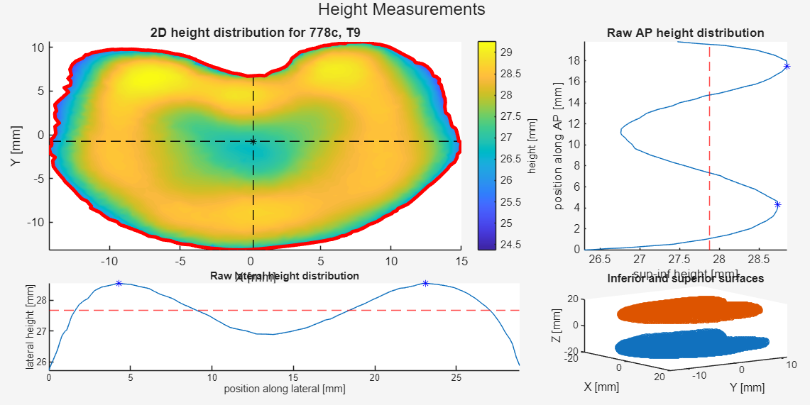
MATLAB Program Overview: Height Measurements

Slide 9
Porcine Subjects Overview
Bulk partitions:
Diseased/ Section | Lumbar | Thoracic
Control | 30 | 70
Kyphotic | 24 | 45
# of subjects: 9
# of kyphotic: 4
# of control: 5
# of vertebral levels: 169
# of kyphotic + control: 69 + 100
# of lumbar + thoracic: 54 + 115

Slide 10
Porcine Subjects Overview
Level-based partition:
Level Name | # of levels | # of control levels | # of kyphotic levels
T1 | 7 | 4 | 3
T2 | 8 | 5 | 3
T3 | 7 | 4 | 3
T4 | 7 | 4 | 3
T5 | 7 | 4 | 3
T6 | 8 | 5 | 3
T7 | 8 | 5 | 3
Level Name | # of levels | # of control levels | # of kyphotic levels
T8 | 7 | 4 | 3
T9 | 8 | 5 | 3
T10 | 8 | 5 | 3
T11 | 8 | 5 | 3
T12 | 8 | 5 | 3
T13 | 8 | 5 | 3
T14 | 8 | 5 | 3
Level Name | # of levels | # of control levels | # of kyphotic levels
T15 | 8 | 5 | 3
L1 | 9 | 5 | 4
L2 | 9 | 5 | 4
L3 | 8 | 5 | 4
L4 | 9 | 5 | 4
L5 | 9 | 5 | 4
L6 | 9 | 5 | 4

Slide 11
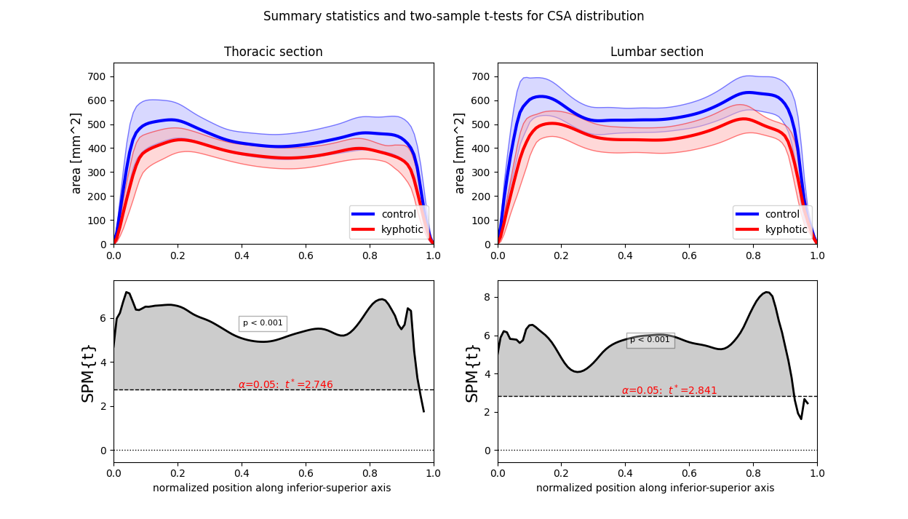
Summary Statistics and Test: Cross Sectional Area
Statistical test method: 1D continuous two-sample t-test
Assumptions
Unequal variance
Hypothesis is one-directional
Normally distributed
*p-value indicates the probability that smooth, random continua would produce a supra-threshold cluster as broad as the observed cluster
Inferior
Superior

Slide 12
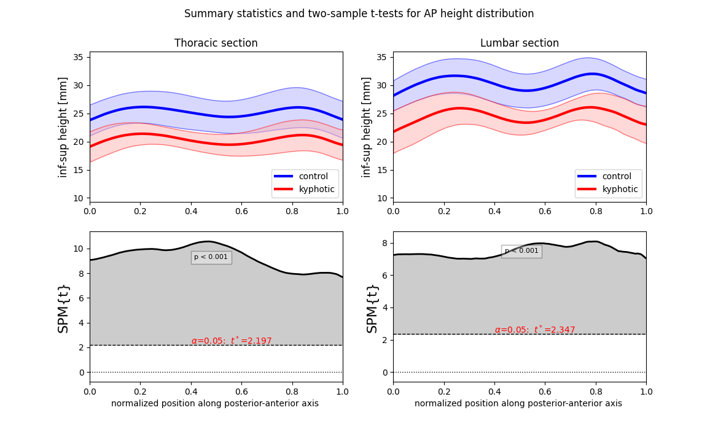
Summary Statistics and Test: AP Height
Statistical test method: 1D continuous two-sample t-test
Assumptions
Unequal variance
Hypothesis is one-directional
Normally distributed
*p-value indicates the probability that smooth, random continua would produce a supra-threshold cluster as broad as the observed cluster
Posterior
Anterior

Slide 13
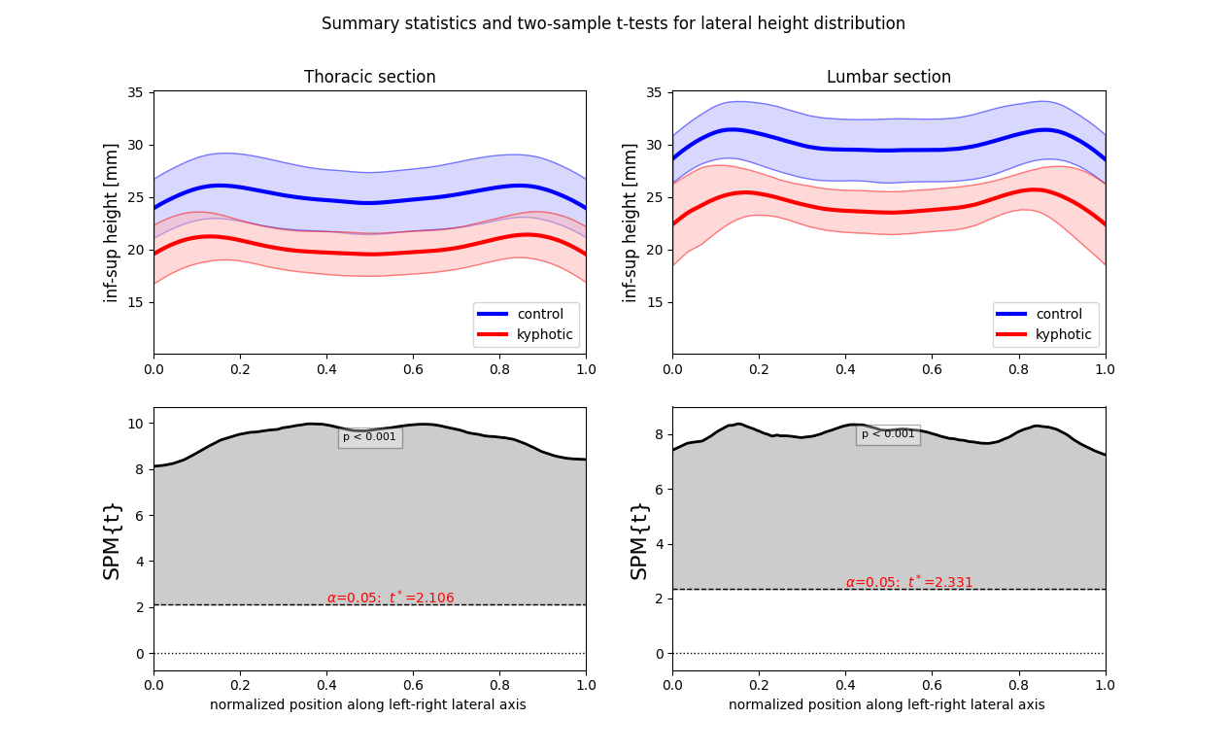
Summary Statistics and Test: Lateral Height
Statistical test method: 1D continuous two-sample t-test
Assumptions
Unequal variance
Hypothesis is one-directional
Normally distributed
*p-value indicates the probability that smooth, random continua would produce a supra-threshold cluster as broad as the observed cluster
Left
Right

Slide 14
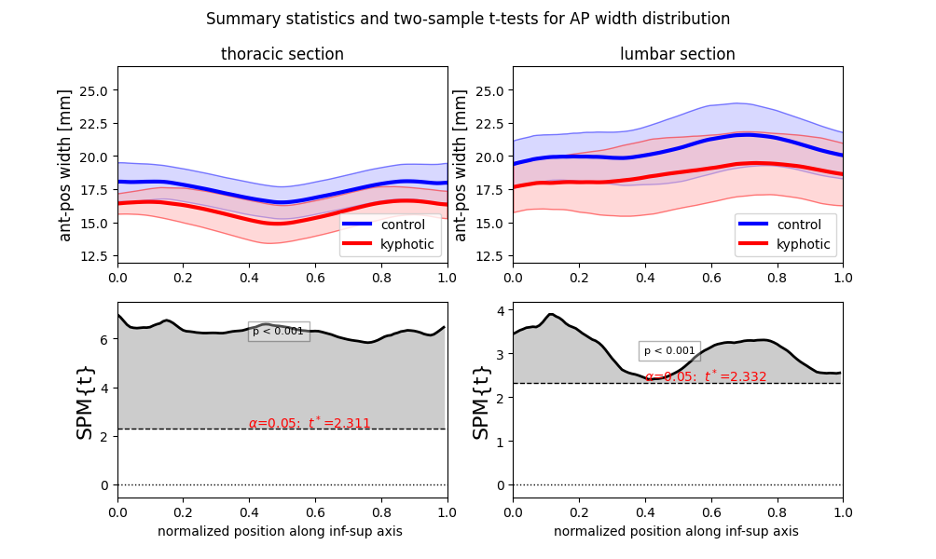
Summary Statistics and Test: AP Width
Statistical test method: 1D continuous two-sample t-test
Assumptions
Unequal variance
Hypothesis is one-directional
Normally distributed
“Anterior growth” in scoliotic subjects?
*p-value indicates the probability that smooth, random continua would produce a supra-threshold cluster as broad as the observed cluster
Inferior
Superior

Slide 15
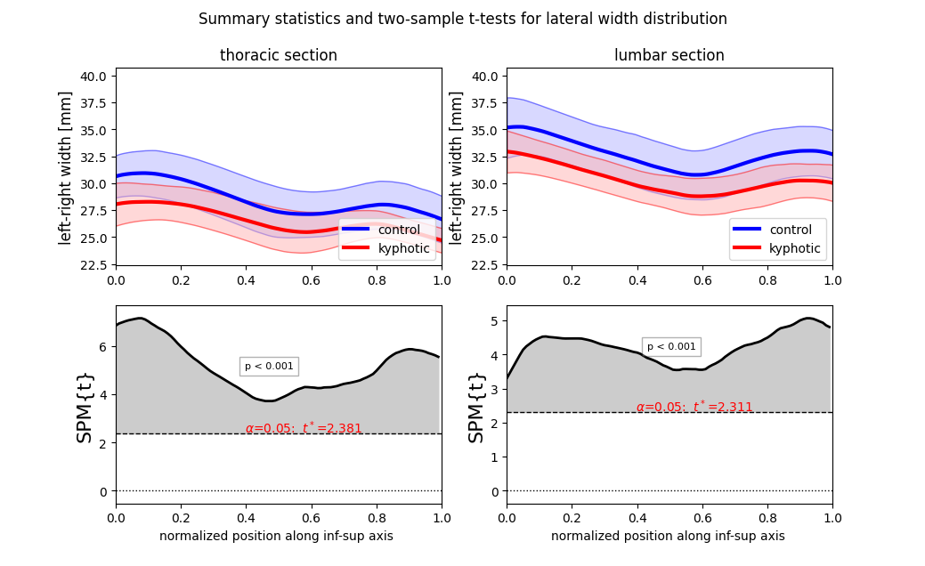
Summary Statistics and Test: Lateral Width
Statistical test method: 1D continuous two-sample t-test
Assumptions
Unequal variance
Hypothesis is one-directional
Normally distributed
*p-value indicates the probability that smooth, random continua would produce a supra-threshold cluster as broad as the observed cluster
Inferior
Superior

Slide 16
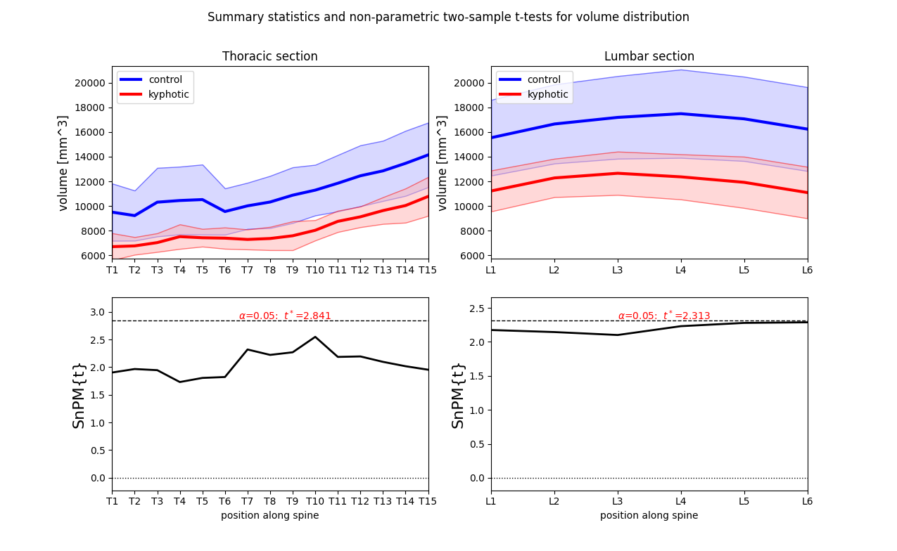
Summary Statistics and Test: Volume
Statistical test method: 1D continuous two-sample, non-parametric t-test
Assumptions
Hypothesis is one-directional
Non-gaussian distribution
*p-value indicates the probability that smooth, random continua would produce a supra-threshold cluster as broad as the observed cluster

Slide 17
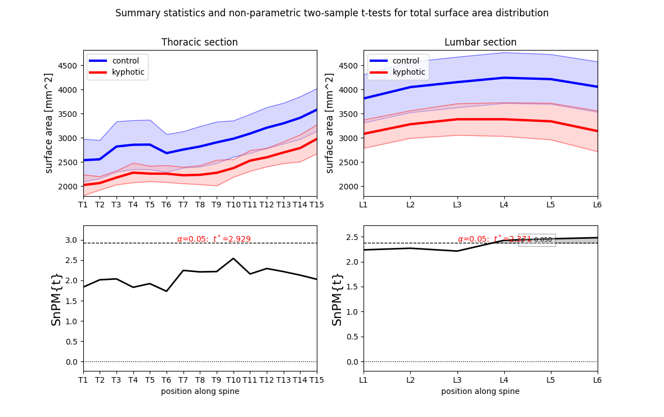
Summary Statistics and Test: Total Surface Area
Statistical test method: 1D continuous two-sample, non-parametric t-test
Assumptions
Hypothesis is one-directional
Non-gaussian distribution
*p-value indicates the probability that smooth, random continua would produce a supra-threshold cluster as broad as the observed cluster

Slide 18
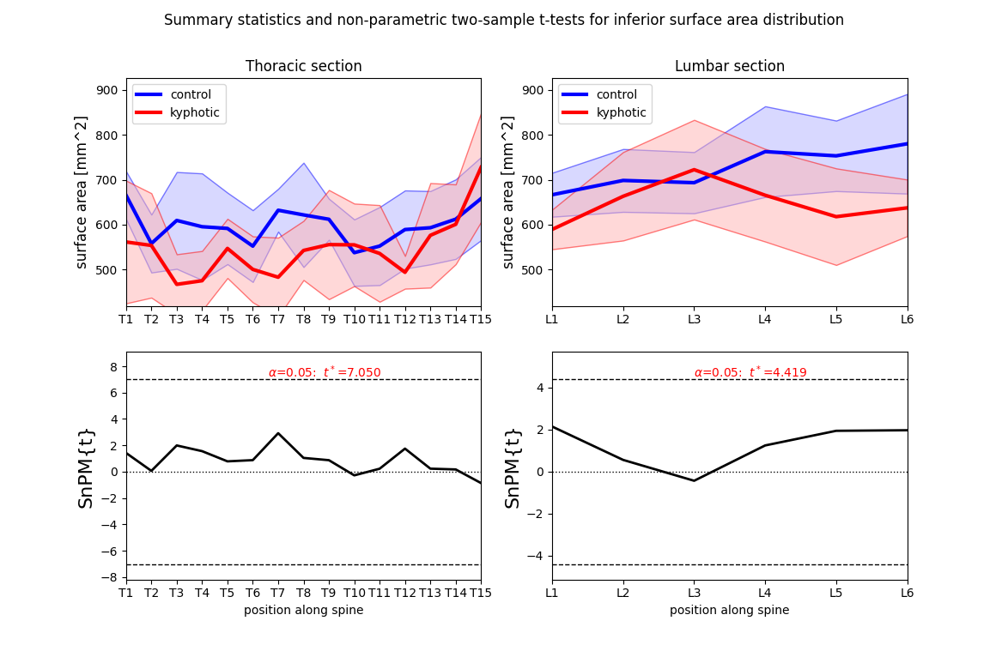
Summary Statistics and Test: Inferior Surface Area
Statistical test method: 1D continuous two-sample, non-parametric t-test
Assumptions
Hypothesis is two-directional
Non-gaussian distribution
*p-value indicates the probability that smooth, random continua would produce a supra-threshold cluster as broad as the observed cluster

Slide 19
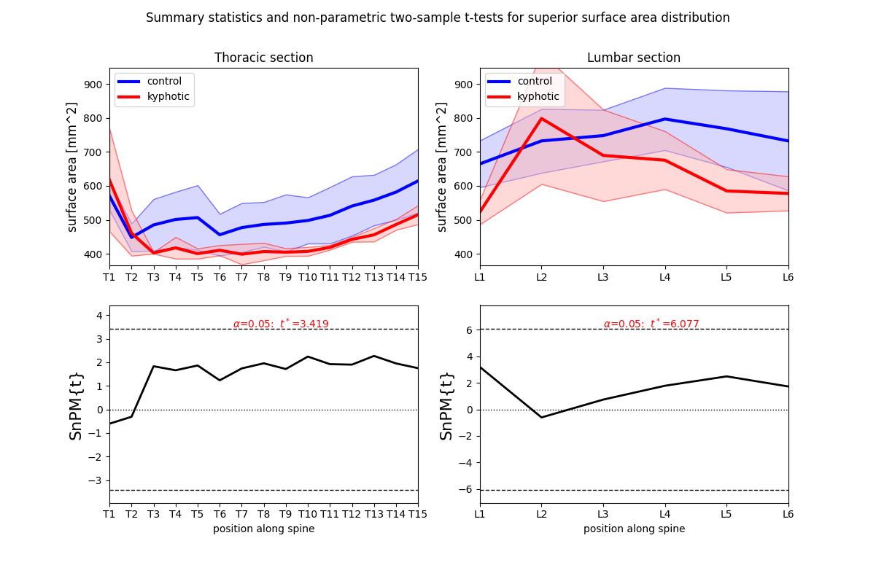
Summary Statistics and Test: Superior Surface Area
Statistical test method: 1D continuous two-sample, non-parametric t-test
Assumptions
Hypothesis is two-directional
Non-gaussian distribution
*p-value indicates the probability that smooth, random continua would produce a supra-threshold cluster as broad as the observed cluster

Slide 20
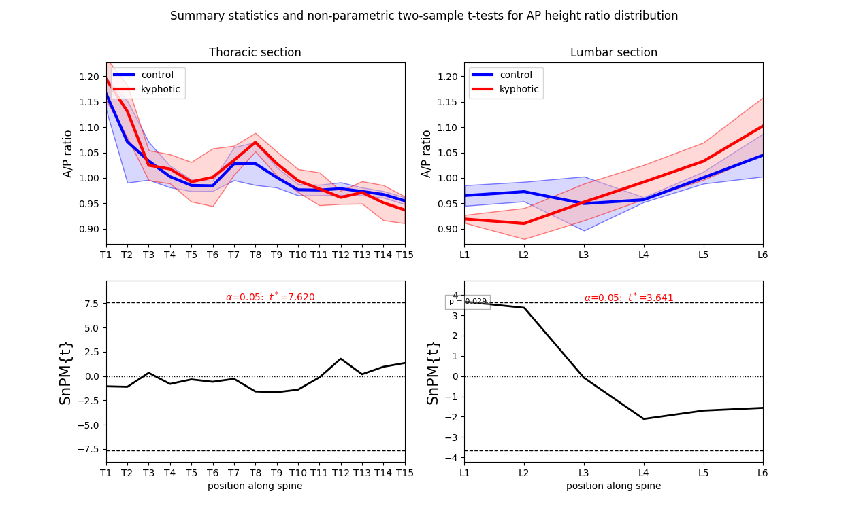
Summary Statistics and Test: A/P Height Ratio
Statistical test method: 1D continuous two-sample, non-parametric t-test
Assumptions
Hypothesis is two-directional
Non-gaussian distribution
*p-value indicates the probability that smooth, random continua would produce a supra-threshold cluster as broad as the observed cluster

Slide 21
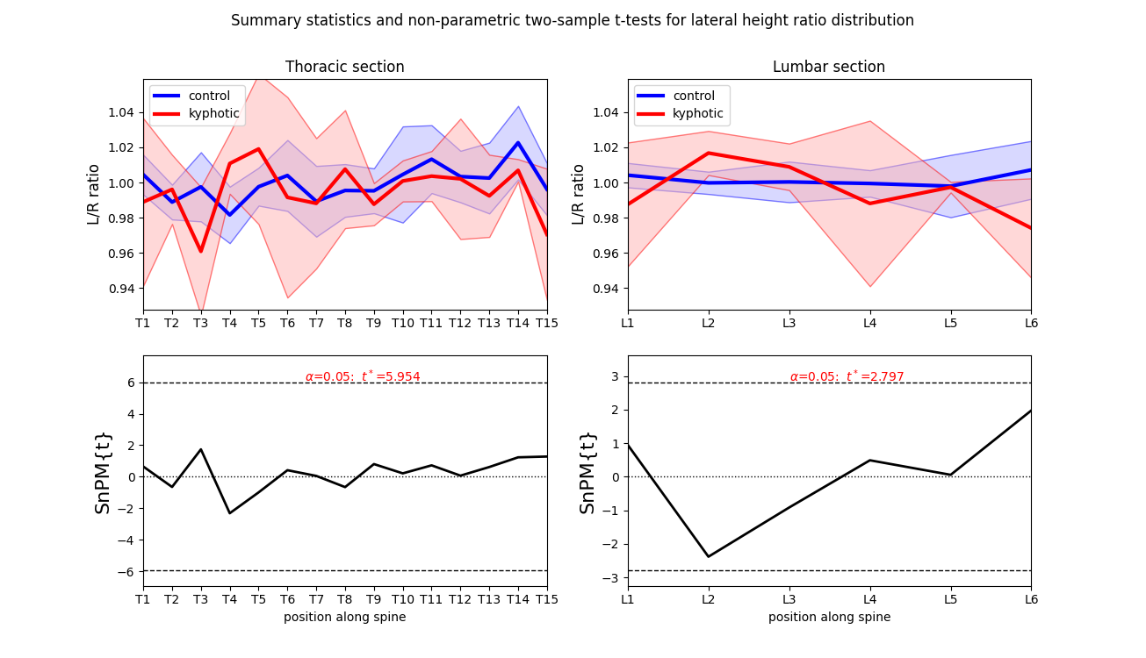
Summary Statistics and Test: L/R Height Ratio
Statistical test method: 1D continuous two-sample, non-parametric t-test
Assumptions
Hypothesis is two-directional
Non-gaussian distribution
*p-value indicates the probability that smooth, random continua would produce a supra-threshold cluster as broad as the observed cluster

Slide 22
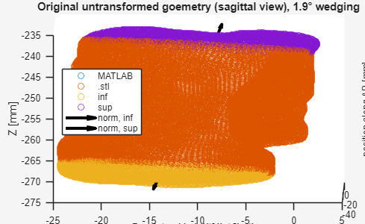
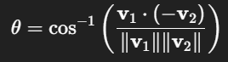
Summary Statistics and Test: Vertebral Body Wedging
Vertebral Body Wedging Measurement Procedure:
Red = vertebra body
Purple = superior surface
Yellow = inferior surface
Black = averaged normal vectors
*Normal vectors defined to point outwards
Vertebral body wedging = angle between superior normal angle and (anti-parallel) inferior normal angle

Slide 23
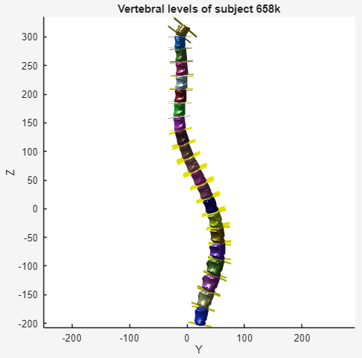
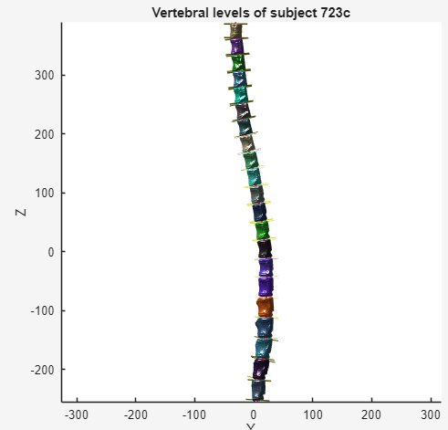
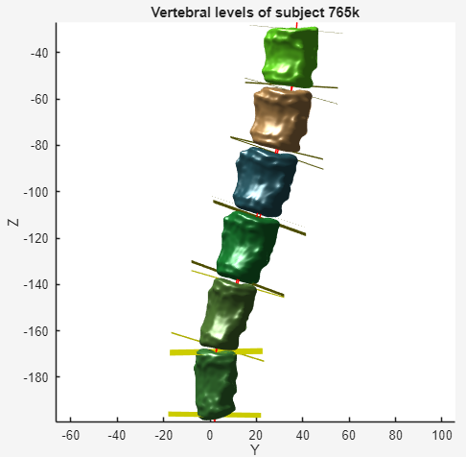
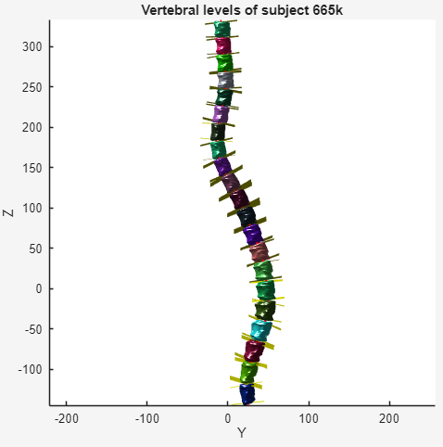
Summary Statistics and Test: Vertebral Body Wedging
Example normal plane distributions wrt to spinal location:

Slide 24
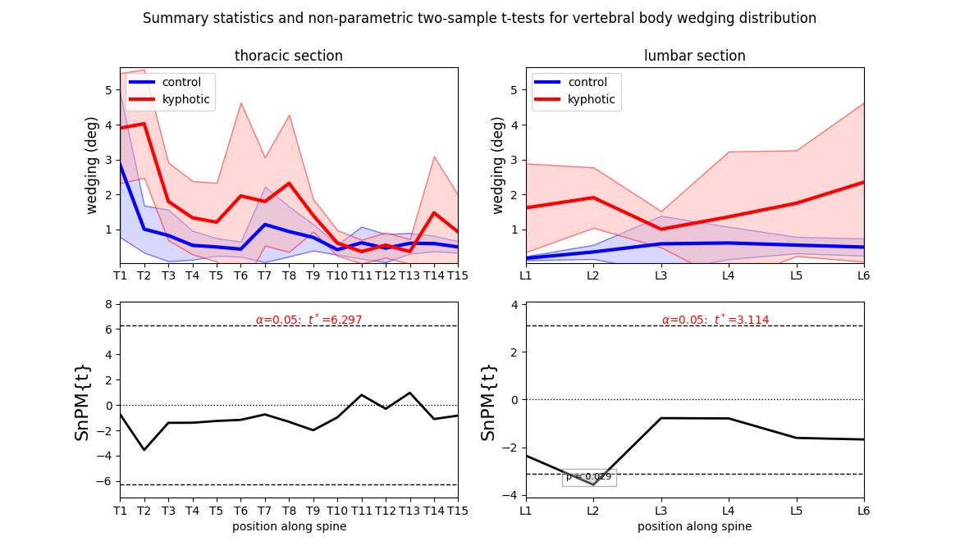
Summary Statistics and Test: Vertebral Body Wedging
Statistical test method: 1D continuous two-sample, non-parametric t-test
Assumptions
Hypothesis is two-directional
Non-gaussian distribution
*p-value indicates the probability that smooth, random continua would produce a supra-threshold cluster as broad as the observed cluster

Slide 25
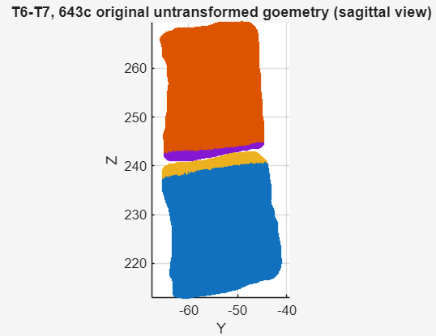
MATLAB Program Overview
Disc Construction Procedure
Step 1:
Obtain point cloud representations of superior + inferior surfaces
Red = superior vertebra
Blue = inferior vertebra
Purple = superior (surface of) disc
Yellow = inferior (surface of) disc

Slide 26
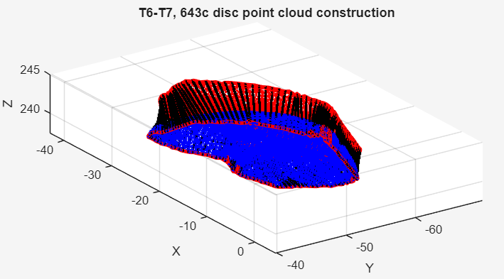
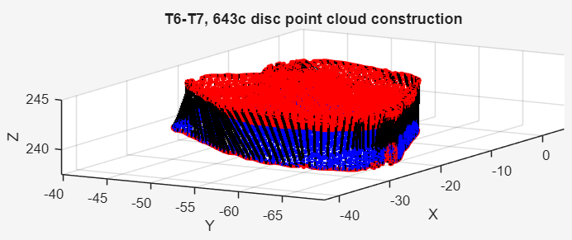
MATLAB Program Overview
Disc Construction Procedure
Step 2:
Create an “intermediate” surface by (linearly) interpolating between superior + inferior surfaces
Red = superior surface of disc
Blue = inferior surface of disc
Black = intermediate surface of disc

Slide 27
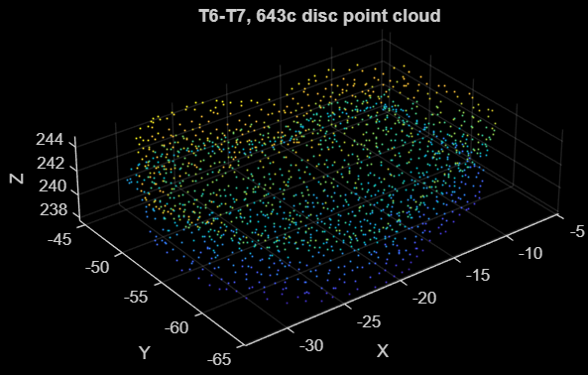
MATLAB Program Overview
Disc Construction Procedure
Step 3:
Convert to point cloud object and downsample point distribution
Downsampling simplifies the .stl mesh construction process
Leads to more jagged surface reconstruction

Slide 28
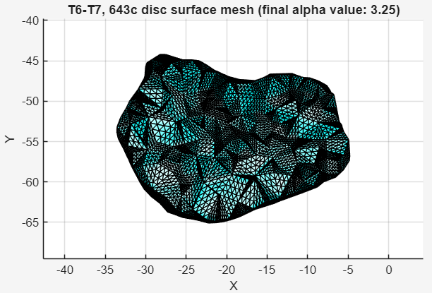
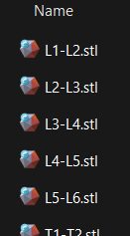
MATLAB Program Overview
Disc Construction Procedure
Step 4:
Triangulating point cloud and exporting geometry as an .stl file
Note: .stl generation is done with alphashape method, which determines the tightness of its boundary with the alpha parameter

Slide 29
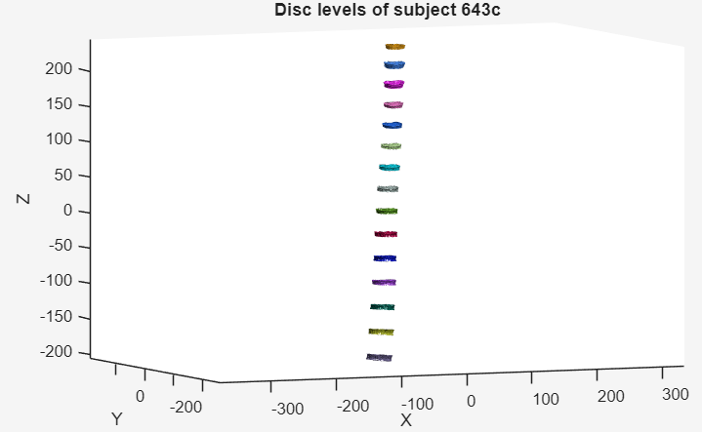
MATLAB Program Overview
Disc Construction Procedure
Overview:
Constructed disc geometries in between each possible vertebral level (in the original coordinate system)
Guarantees watertightness with the alphashape method
Vertebra-disc surface conformity is not guaranteed because of triangulation + downsampling

Slide 30
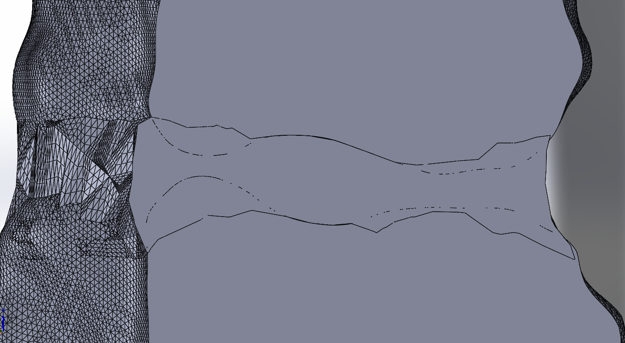
MATLAB Program Overview
Disc Construction Procedure
Overview:
Still a notable amount of overlap between vertebrae-disc interface
.stl mesh generation is harder where higher point density is required

Slide 31
Porcine Subjects Overview
Bulk disc partitions:
Diseased/ Section | Lumbar | Thoracic
Control | 30 | 63
Kyphotic | 23 | 42
# of subjects: 9
# of kyphotic: 4
# of control: 5
# of disc levels: 158
# of kyphotic + control: 65 + 93
# of lumbar + thoracic: 53 + 105
*T15-L1 disc considered to be a lumbar disc

Slide 32
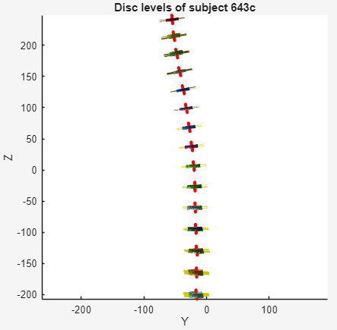
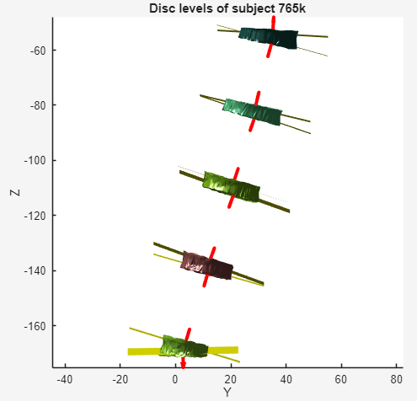
Summary Statistics and Test: Disc Wedging
Example normal plane distributions wrt to spinal location:
Disc wedging used same (opposite) normal vectors as computed from the VB wedging, but with adjusted indexing

Slide 33
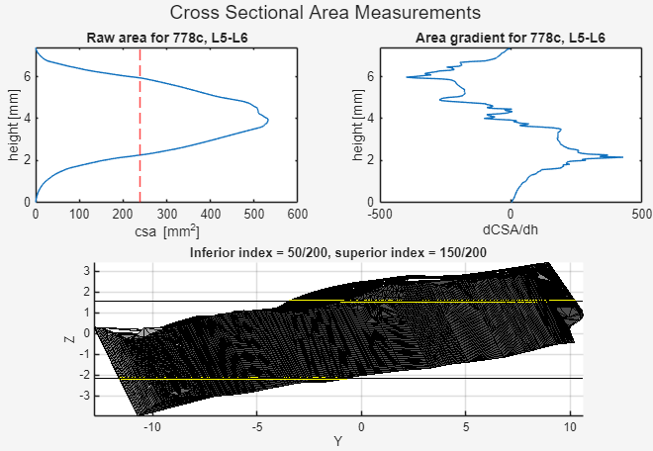
MATLAB Program Overview: Disc CSA Measurements

Slide 34
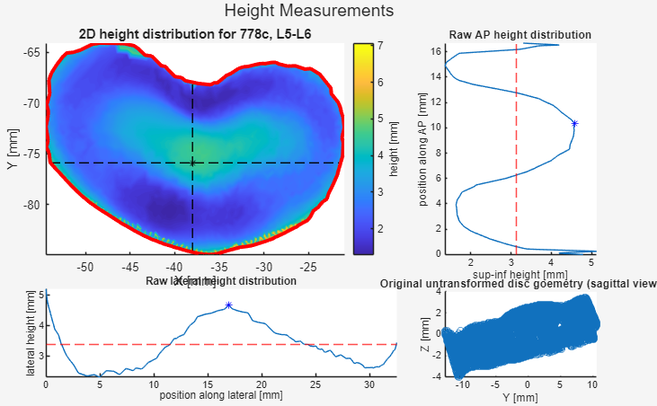
MATLAB Program Overview: Disc CSA Measurements

Slide 35
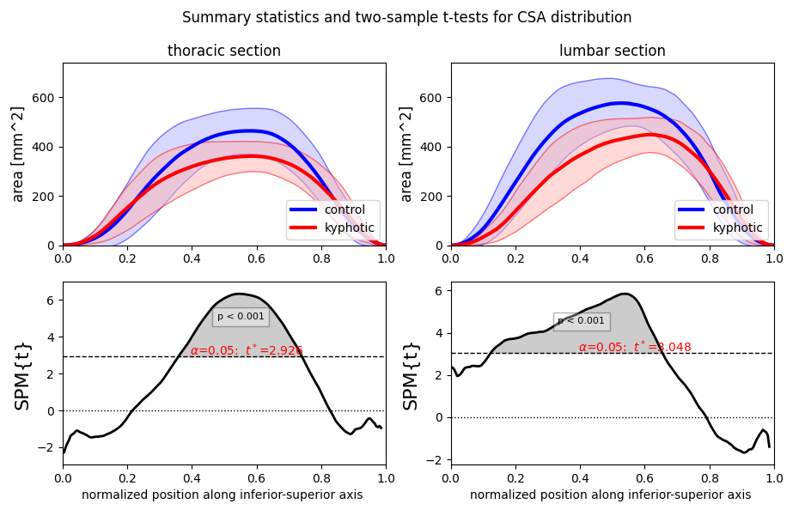
Summary Statistics and Test: Disc Cross Sectional Area
Statistical test method: 1D continuous two-sample t-test
Assumptions
Unequal variance
Hypothesis is one-directional
Normally distributed
*p-value indicates the probability that smooth, random continua would produce a supra-threshold cluster as broad as the observed cluster
Inferior
Superior

Slide 36
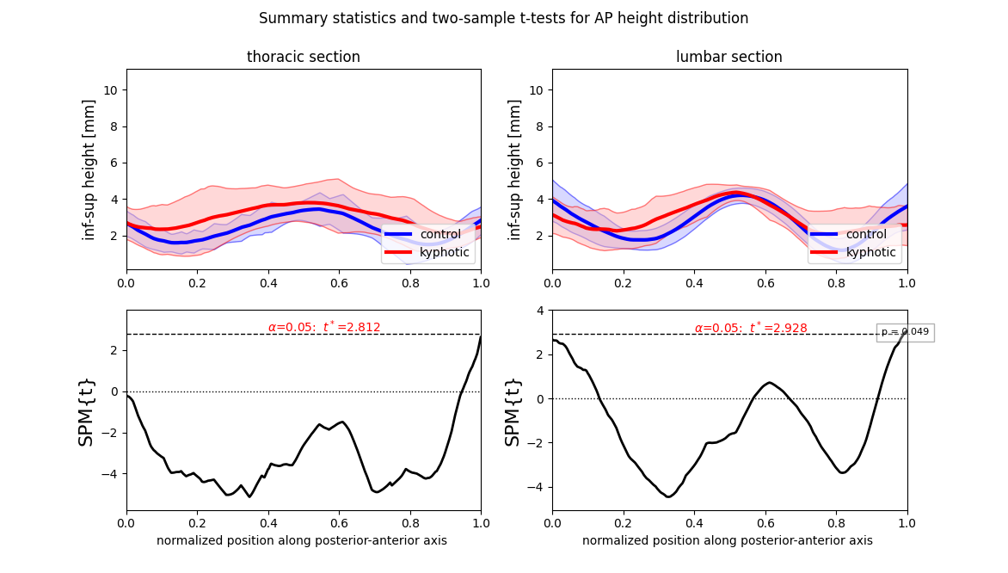
Summary Statistics and Test: Disc AP Height
Statistical test method: 1D continuous two-sample t-test
Assumptions
Unequal variance
Hypothesis is one-directional
Normally distributed
*p-value indicates the probability that smooth, random continua would produce a supra-threshold cluster as broad as the observed cluster
Posterior
Anterior

Slide 37
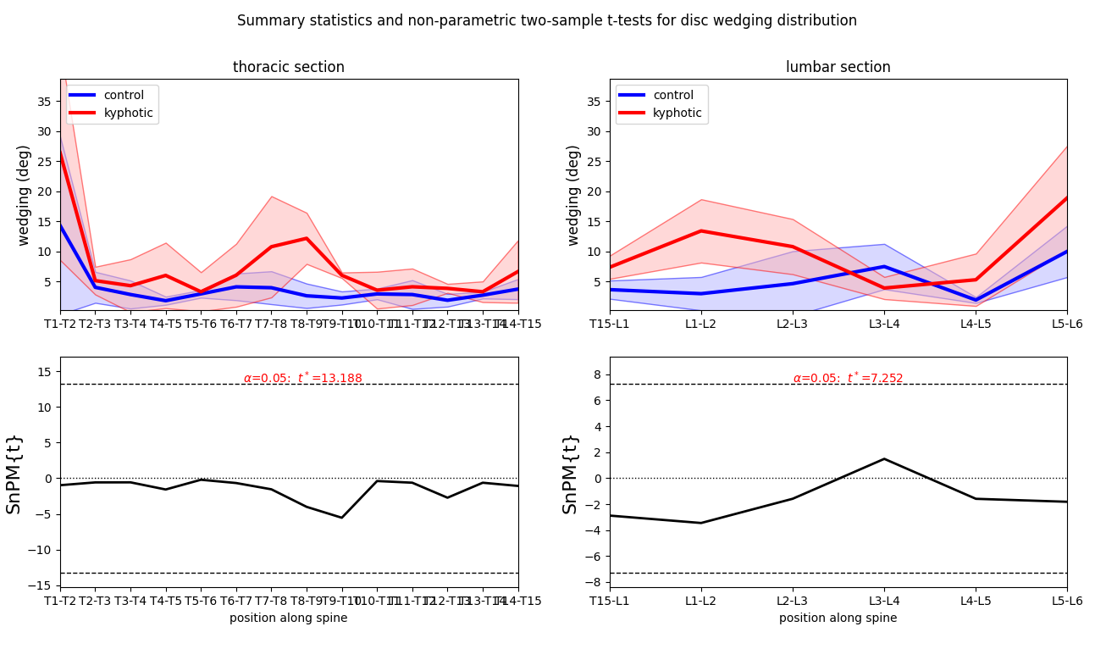
Summary Statistics and Test: Disc Wedging
Statistical test method: 1D continuous two-sample, non-parametric t-test
Assumptions
Hypothesis is two-directional
Non-gaussian distribution
*p-value indicates the probability that smooth, random continua would produce a supra-threshold cluster as broad as the observed cluster

Slide 38
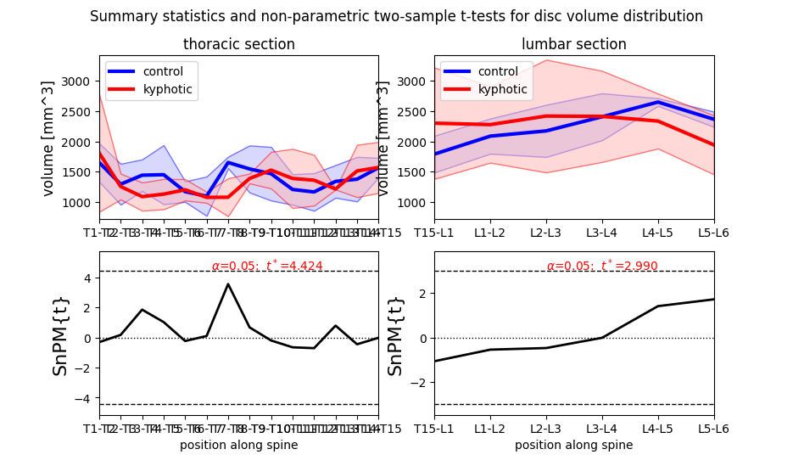
Summary Statistics and Test: Disc Volume
Statistical test method: 1D continuous two-sample, non-parametric t-test
Assumptions
Hypothesis is two-directional
Non-gaussian distribution
*p-value indicates the probability that smooth, random continua would produce a supra-threshold cluster as broad as the observed cluster

Slide 39
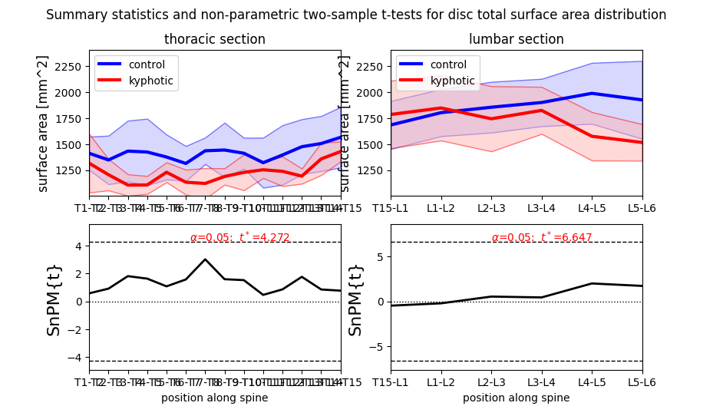
Summary Statistics and Test: Disc Total Surface Area
Statistical test method: 1D continuous two-sample, non-parametric t-test
Assumptions
Hypothesis is two-directional
Non-gaussian distribution
*p-value indicates the probability that smooth, random continua would produce a supra-threshold cluster as broad as the observed cluster

Slide 40
Geometry Statistics Summary
Control VS Kyphotic:
Significance | Mixed/marginal significance | Insignifiance
CSA, height, AP + lateral width | Volume, total surface area, AP height ratio, vertebral wedging | Inferior and superior surface area, LR height ratio, disc wedging
Reflections:
Control vertebrae are higher in CSA and height than kyphotic vertebrae, but control disc are only thicker than kyphotic disc (no height differences)
Disc shape is not altered by kyphosis (observed by comparing inferior + superior surface areas of vertebrae)
Kyphosis is a anterior-posterior phenomena → potential AP height ratio significance
Vertebral wedging more significant than disc wedging
Relative contribution of vertebra + disc wedging wrt time of diagnosis has been discussed extensively in Stokes et al. 2001, Upasani et al. 2011, Will et al. 2009, Schlosser et al. 2014, etc…
Potential discussion point: scoliosis begins with disc wedging but cascades into vertebral wedging at the time of operation

